Slide 1
Controlling the Complexity of Software Designs
Karl Lieberherr
College of Computer and Information Science
Northeastern University
DEMETER
ΔΗΜΗΤΡΑ
Notes:
This is a special day for me. When I was half my current age, I came the first time to Edinburgh as a young PhD student
At the Swiss Federal Institute of Technology. It is a great pleasure to be back in Edinburgh as a keynote speaker of ICSE.

Slide 2
My first conference experience
3. ICALP 1976: Edinburgh, U.K.
S. Michaelson, Robin Milner (Eds.): Third International Colloquium on Automata, Languages and Programming, University of Edinburgh, July 20-23, 1976.

Slide 3
For your personal life:
Always talk to strangers.
But in your software:
Talk only to your friends who contribute to your concerns.
Notes:
Dance with them, sing with them and laugh with them independent of their religion or political view.
In other words, I want you to be open and adventurous
Conservative
We will spend the next hour on this style rule:
What are the implications? What are the different applications?
What kind of technology do we need to support this style rule
Second phrase is new

Slide 4
Thesis
The Law of Demeter for Concerns (LoDC) helps you to better apply, explain and understand Aspect-Oriented Software Development (AOSD):
  LoDC: Talk only to your friends who contribute to your concerns.
  AOSD: Modularizing crosscutting concerns.
  Concern: Any issue the developer needs to deal with: a use case, a caching policy, …

Slide 5
Supporting Claims
Current AOSD tools (AspectJ, Demeter, etc.) provide support for following the LoDC.
The LoDC leads to structure-shyness and concern-shyness which leads to better AOSD.

Slide 6
Outline
AOSD
The LoD and LoDC
AOSD Tools support LoDC
LoDC leads to better AOSD
Conclusions

Slide 7
Outline as a picture
Structure-shyness
leads to
improves
LoD
AOSD
implies
support
AOSD Tools
LoDC
leads to

Slide 8
Meta thesis
The LoDC is a simple tool to explain something new and unfamiliar (AOSD) that is important to you.
Grounded on familiar LoD.
Need style rule for aspects:
  LoD is good for object-oriented software development
  LoDC is good for aspect-oriented software development.
Notes:
Show them backbone in writing, add meat by talking
Other style rules equally important

Slide 9
What is AOSD?
Modularize concerns whose ad hoc implementation would be scattered across many classes or methods.
Slogan: Modularize Crosscutting Concerns.
Notes:
Use case: gathering information from an object
Focus on OOSD

Slide 10
AOSD and LoDC as Software Development Approaches
AOSD is an approach to software development that supports modularizing concern implementations that cut across other concern implementations.
LoDC is an approach to software development that supports incremental development, concern by concern.

Slide 11
Outline
AOSD
  What is AOSD?
  AOSD as an emerging technology
The LoD and LoDC
AOSD Tools support LoDC
  AspectJ supports LoDC
  Demeter supports LoDC
LoDC leads to better AOSD
  From LoD to structure-shyness and better AOSD
  Information hiding and LoDC
Conclusions

Slide 12
interface ShapeI extends Remote {
double get_x() throws RemoteException ;
void set_x(int x) throws RemoteException ;
double get_y() throws RemoteException ;
void set_y(int y) throws RemoteException ;
double get_width() throws RemoteException ;
void set_width(int w) throws RemoteException ;
double get_height() throws RemoteException ;
void set_height(int h) throws RemoteException ;
void adjustLocation() throws RemoteException ;
void adjustDimensions() throws RemoteException ;
}
Modularization of
crosscutting concerns
public class Shape
implements ShapeI {
protected AdjustableLocation loc;
protected AdjustableDimension dim;
public Shape() {
loc = new AdjustableLocation(0, 0);
dim = new AdjustableDimension(0, 0);
}
double get_x() throws RemoteException {
return loc.x(); }
void set_x(int x) throws RemoteException {
loc.set_x(); }
double get_y() throws RemoteException {
return loc.y(); }
void set_y(int y) throws RemoteException {
loc.set_y(); }
double get_width() throws RemoteException {
return dim.width(); }
void set_width(int w) throws RemoteException {
dim.set_w(); }
double get_height() throws RemoteException {
return dim.height(); }
void set_height(int h) throws RemoteException {
dim.set_h(); }
void adjustLocation() throws RemoteException {
loc.adjust();
}
void adjustDimensions() throws RemoteException {
dim.adjust();
}
}
public class Shape {
protected double x_= 0.0, y_= 0.0;
protected double width_=0.0, height_=0.0;
double get_x() { return x_(); }
void set_x(int x) { x_ = x; }
double get_y() { return y_(); }
void set_y(int y) { y_ = y; }
double get_width(){ return width_(); }
void set_width(int w) { width_ = w; }
double get_height(){ return height_(); }
void set_height(int h) { height_ = h; }
void adjustLocation() {
x_ = longCalculation1();
y_ = longCalculation2();
}
void adjustDimensions() {
width_ = longCalculation3();
height_ = longCalculation4();
}
}
Write
this
coordinator Shape {
selfex adjustLocation, adjustDimensions;
mutex {adjustLocation, get_x, set_x,
get_y, set_y};
mutex {adjustDimensions, get_width, get_height,
set_width, set_height};
}
class AdjustableLocation {
protected double x_, y_;
public AdjustableLocation(double x, double y) {
x_ = x; y_ = y;
}
synchronized double get_x() { return x_; }
synchronized void set_x(int x) {x_ = x;}
synchronized double get_y() { return y_; }
synchronized void set_y(int y) {y_ = y;}
synchronized void adjust() {
x_ = longCalculation1();
y_ = longCalculation2();
}
}
class AdjustableDimension {
protected double width_=0.0, height_=0.0;
public AdjustableDimension(double h, double w) {
height_ = h; width_ = w;
}
synchronized double get_width() { return width_; }
synchronized void set_w(int w) {width_ = w;}
synchronized double get_height() { return height_; }
synchronized void set_h(int h) {height_ = h;}
synchronized void adjust() {
width_ = longCalculation3();
height_ = longCalculation4();
}
}
Instead of
writing this
portal Shape {
double get_x() {} ;
void set_x(int x) {};
double get_y() {};
void set_y(int y) {};
double get_width() {};
void set_width(int w) {};
double get_height() {};
void set_height(int h) {};
void adjustLocation() {};
void adjustDimensions() {};
}
Crista Lopes 1995
COOL, RIDL
Notes:
High-level motivation

Slide 13
The Intuition behind Aspects as Components
aspects
Mira Mezini (1998)
classes
connectors

Slide 14
AOSD as an Emerging Technology
First I want to position AOSD as an important emerging technology.
  Statement from IBM at AOSD 2004.
  A case study of AspectJ usage from a paper by Colyer and Clement at AOSD 2004. Also used by LoDC explanation.
  More on AspectJ successes.

Slide 15
Daniel Sabbah (IBM VP for Software): Quotes from Conclusions at AOSD 2004
AOSD’s time has come.
  The Software Industry needs it, and IBM is using it now.
IBM is taking AOSD very seriously.
  From a technical and business perspective
  AOSD has development impact today across all major IBM brands –
    Tivoli, WebSphere, DB2, Lotus, Rational

Slide 16
How is AOSD technology currently used?
Large-scale AOSD for Middleware
Adrian Colyer and Andrew Clement
IBM UK, in Proceedings AOSD 2004.
From the Abstract:
“We also wanted to know whether aspect-oriented techniques could scale to commercial project sizes with tens of thousands of classes, many millions of lines of code, hundreds of developers, and sophisticated build systems.”

Slide 17
From: Large Scale AOSD for Middleware
They were able to capture the extensive logging policy in an aspect that defined both when and how logging was to be performed.
Note: They applied AOSD to many other concerns!

Slide 18
Logging in AspectJ
When
WhatToDo
May affect
Hundreds of
Places
8000 places
(IBM report)
aspect Logging{
LogFile l;
pointcut traced():
call(void *.update()) ||
call(void *.repaint());
before():traced(){
l.log(“Entering:”+
thisJoinPoint);}
}
Notes:
Not the logging in IBM application.

Slide 19
Manual alternative
Mistakes that happened:
  Some extra methods may be logged.
  Some methods are forgotten to be logged.
  Some logging methods may not be properly guarded.
From Colyer/Clement: “The aspect-based solution gave a more accurate and more complete implementation of the tracing policy… All of these mistakes are the natural consequence of asking humans to perform mundane and repetitive work.”

Slide 20
More AspectJ Successes
4 published trade press books with more coming.
Hand-coded alternatives accuracy 70%-80%.
Used in production applications around the world.
Popular in J2EE community.
IBM will soon ship AspectJ code in Websphere.
Notes:
Thanks to Gregor Kiczales

Slide 21
Other Examples of Commercially Used AOP Tools
AspectWerkz
  Supported by BEA
Spring AOP framework
JBoss AOP
CME (Concern Manipulation Environment)
  Supported by IBM

Slide 22
Outline
AOSD
The LoD and LoDC
AOSD supports LoDC
LoDC leads to better AOSD
Conclusions

Slide 23
The LoD and LoDC
LoD: Talk only to your friends.
  Control information overload
  How to organize inside a set of concern implementations.
LoDC: Talk only to your friends who contribute to your concerns.
  Better control of information overload and control of scattering.
  Separate outside concerns.
LoDC implies LoD.
Notes:
LoD: function follows structure

Slide 24
LoDC and Contracting
Contracting buyer, contracting provider
Crosscutting interaction pattern
Contracting benefits
  More agile
  Better service, Amortization
Talk only to your friends who contribute to your concerns

Slide 25
Law of Demeter (LoD)
Talk only to your friends
you
FRIENDS

Slide 26
OO interpretation of LoD
Talk only to your friends
  Class form: you = method of class, talk = use, friends = preferred supplier classes
  Object form: you = method of object, talk = send message, friends = preferred supplier objects

Slide 27
Preferred supplier objects of a method
the immediate parts of this (computed or stored)
the method’s argument objects (which includes this)
the objects that are created directly in the method

Slide 28
LoD Formulation (object form)
Inside a method M we must only call methods of preferred supplier objects (for all executions of M).
Expresses the spirit of the basic LoD and serves
as a conceptual guideline for you to approximate.
A job interview question

Slide 29
Violating the LoD (example by David Bock)
In class PaperBoy:
  customer.wallet.money;
  customer.apartment.kitchen.
  kitchenCabinet.money;
  customer.apartment.bedroom.mattress.money;

Slide 30
Explaining LoDC
Base application deals with set of concerns Cs.
A new concern D needs to be dealt with that requires additional method and/or method calls.
Those methods or method calls do not contribute to Cs.
Therefore, the methods and/or calls required by D need to be factored out into a modular unit called a complex request.
LoDC = Talk only to your friends who contribute to your concerns

Slide 31
LoDC: Talk only to your friends who contribute to your concerns.
When your concerns change the set of contributing friends changes.
You talk to friends that don’t contribute to your concerns through a complex request.
  Such a complex request (e.g., Logging) may modularize many communications that would otherwise be scattered across many classes and methods.

Slide 32
Law of Demeter for Concerns (LoDC)
contributing friends
you
FRIENDS

Slide 33
Law of Demeter for Concerns (LoDC)
contributing friends
FRIENDS
l:LogFile
you
coordinates
Complex request

Slide 34
Outline
Missing:
Subject-Oriented Prog.
Hyper/J
Composition Filters
etc.
AOSD
The LoD and LoDC
AOSD supports LoDC
  AspectJ supports LoDC
  Demeter supports LoDC
LoDC leads to better AOSD
Conclusions

Slide 35
Use Logging example to explain LoDC
Base application deals with a set of concerns Cs different from Logging.
The logging object, although it may be a friend, does not contribute to Cs.
Therefore, the calls to the logging object need to be factored out.
LoDC = Talk only to your friends who contribute to your concerns

Slide 36
AspectJ
When
WhatToDo
aspect Logging{
LogFile l;
pointcut traced():
call(void *.update()} ||
call(void *.repaint();
before():traced(){
l.log(“Entering:”+
thisJoinPoint);}
}
// follows LoDC
How does AspectJ support the LoDC?
Inserting calls l.log() manually would violate LoDC because logging is an intrusive new concern that is not part of the current concerns.
Notes:
Explained LoDC generically and using AspectJ. Showed how AspectJ helps follow LoDC.
Want to do the same for Demeter.

Slide 37
AspectJ provides general purpose support for LoDC.
You: object
Talk: Method calls
Friends contributing to concerns: method calls (BaseApp)
Concerns:
  Old: BaseApp
  New: WhenAndWhatToDo
Coordinates: execution points in BaseApp
Examples:
  Where: void before (): execution_points_in_BaseApp()
  Weave: ajc BaseApp.java WhenAndWhatToDo.java

Slide 38
Implementing the LoD in AspectJ
Supplier
Aspect Diagram
TargetBinStack
ImmediatePartBin
ArgumentBin
Checker
LocallyConstructedBin
uses pointcuts
Requirements:
ReturnValueBin
Statistics
GlobalPreferredBin
Good Separation of Concerns in Law of Demeter Checker
LoD – LoDC – aspects – LoD checking with aspects
Notes:
Another way how AspectJ supports the LoD

Slide 39
Outline
AOSD
The LoD and LoDC
AOSD supports LoDC
  AspectJ supports LoDC
  Demeter supports LoDC
LoDC leads to better AOSD
Conclusions

Slide 40
Basili’s work
Basili et al., A Validation of Object-Oriented Design Metrics As Quality Indicators, IEEE TSE Vol. 22, No. 10, Oct. 96
Predictors of fault-prone classes?
8 medium sized information management systems

Slide 41
Metric
CBO metric: coupling between classes: a class is coupled to another one if it uses its member functions and/or instance variables.

Slide 42
Hypothesis
H-CBO: Highly coupled classes are more fault-prone than weakly coupled classes.

Slide 43
Result
Indeed, highly coupled classes are more fault-prone than weakly coupled classes.
  Corollary: Classes that follow the LoD are less coupled and are therefore less fault-prone.

Slide 44
Demeter Motivation
Demeter reduces the coupling in two stages:
  Following the Law of Demeter using standard object-oriented techniques eliminates the obviously bad coupling.
  Traversal strategies reduce the coupling further by coupling only with (distant) stable friends.
Notes:
Introduce Demeter:
LoD

Slide 45
Booch about the Law of Demeter (LoD)
Quote:
“The basic effect of applying this Law is the creation of loosely coupled classes, whose implementation secrets are encapsulated.”
“Such classes are fairly unencumbered, meaning that to understand the meaning of one class, you need not understand the details of many other classes.”

Slide 46
Rumbaugh about the Law of Demeter (LoD)
Quote:
“Avoid traversing multiple links or methods. A method should have limited knowledge of an object model.”

Slide 47
Agreement that LoD Good Idea
How to follow LoD: good solutions exist but not widely used. Two approaches to following LoD:
  OO approach
  Structure-shy approach using traversal support (selecting a subobject, where to go).

Slide 48
Stable Friends
Redefine! Talk only to your stable friends who contribute to your concerns.
A friend is stable if its definition is unlikely to change if the functional requirements don’t change.
A stable friend may not be an ordinary preferred supplier. It may be a distant stable friend.

Slide 49
Preferred supplier objects of a method: redefined
the stable parts of this (computed or stored)
  Parts reachable by a “short” traversal specification derived from the requirements
the method’s argument objects (which includes this)
the objects that are created directly in the method
Notes:
Misleading: not a subset.say: preferred supplier objects: gets a new definition

Slide 50
Structure-shy Following LoD
C
A
FRIENDS
a
S
X
c
b
a :From S to A
b :From S to B c :From S via X to C
B

Slide 51
Stable Friends
Requirement: count all persons
waiting at any bus stop on a bus route
strategy:
from BusRoute via BusStop via {-> *,waiting,*} to Person
BusRoute
villages
BusStopList
buses
VillageList
busStops
0..*
0..*
BusList
BusStop
Village
waiting
0..*
passengers
Bus
PersonList
Person
0..*
Notes:
Remove villages
Some

Slide 52
Stable Friends
Requirement: count all persons
waiting at any bus stop on a bus route
strategy:
from BusRoute via BusStop via {-> *,waiting,*} to Person
busStops
BusRoute
BusStopList
buses
0..*
BusList
BusStop
waiting
0..*
passengers
Bus
PersonList
Person
0..*
Notes:
Remove villages

Slide 53
Stable Friends
Requirement: count all persons
waiting at any bus stop on a bus route
strategy:
from BusRoute via BusStop via {-> *,waiting,*} to Person
busStops
BusRoute
BusStopList
buses
0..*
BusList
BusStop
0..*
waiting
drinkingCoffee
passengers
Bus
PersonList
Person
0..*
Notes:
Remove villages

Slide 54
Requirements and Stability of Strategies
Strategies should only refer to the high-level terms in the requirements, without referring to accidental details of the current class graph.
Point – Line duality: A functional requirement works with many class graphs (and a class graph may be used to implement many functional requirements).
Unless requirements change, strategy will be stable with respect to many changes in class graph.
Notes:
From Harold Ossher and Michael Jackson

Slide 55
Three kinds of requirement changes
Changes to class graph and functional requirements
Changes to class graph only (villages)
Changes to functional requirements only (count people in buses)
Notes:
(different tax policies: pay per bus stop or per customer)

Slide 56
Stable Friends
Requirement: count all passengers
riding in some bus on a bus route
strategy:
from BusRoute via Bus via {-> *,passengers,*} to Person
BusRoute
BusStopList
busStops
buses
0..*
0..1
BusList
BusStop
approaching
waiting
0..*
Bus
PersonList
passengers
Person
0..*
Notes:
Remove villages

Slide 57
Requirement: count all bus stops where some bus is approaching on a bus route
strategy:
from BusRoute via Bus via {-> *,approaching,*} to BusStop
BusRoute
BusStopList
busStops
buses
0..*
0..1
BusList
BusStop
approaching
waiting
0..*
Bus
PersonList
passengers
Person
0..*
Notes:
Remove villages

Slide 58
Following the LoD
Instead of using (in class PaperBoy)
  customer.wallet.money;
  customer.apartment.kitchen.
  kitchenCabinet.money;
  customer.apartment.bedroom.mattress.money;
Widen the interface of Customer but decrease coupling. int Customer.getPayment(..)
Stable friend is Money in: from Customer to Money.

Slide 59
Equation System
usedVariables = from EquationSystem
through {-> *,rhs,*} to Variable
EquationSystem
equations
Equation_List
Ident
*
lhs
Equation
Variable
Numerical
rhs
Simple
Expression_List
args
Expression
*
LoD
op
Add
Compound
Notes:
Arrow heads

Slide 60
From AspectJ (1997) back to Demeter (1992)
AspectJ
Demeter (e.g., DJ)
When (pointcut)
  set of execution points of any method, …
  rich set of primitive pointcuts: this, target, call, execution … + set operations
  when to enhance
WhatToDo (advice)
  how to enhance
When (visitor signature)
  set of execution points of traversal methods
  specialized set of pointcuts for traversal methods (node, edge)
  when to enhance
WhatToDo (visitor body)
  how to enhance
DAJ = Efficient version of DJ as AspectJ extension
Notes:
Gives a hint at how to implement Demeter using AspectJ:DAJ

Slide 61
AspectJ Java+DJ
When
WhatToDo
aspect Logging{
LogFile l;
pointcut traced():
call(void *.update()) ||
call(void *.repaint());
before():traced(){
l.log(“Entering:”+
thisJoinPoint);}
}
class Source{
HashSet collect(ClassGraph cg)
{return (HashSet)
cg.traverse(this,
“from Source to Target”,
new Visitor(){ … ;
public void before
(Target h) { … }
public void start() {…}});
}
}
Notes:
Both aspects may affect 1000 classes
Different: each one showing some benefits of the respective language

Slide 62
How DJ works
Make concepts of Demeter available as Java classes:
  ClassGraph (Object structure): method traverse(Object, WhereToGo, WhenAndWhatToDo)
  Strategy = String (WhereToGo)
  Visitor (WhenAndWhatToDo)

Slide 63
Implementation of strategies
Three layers of graphs:
  Selector language: strategy graphs
  Meta information: class graphs
  Instances: object graphs
View the first two as non-deterministic automata
Algorithm motivated by product of non-deterministic automata: implemented by AP Library

Slide 64
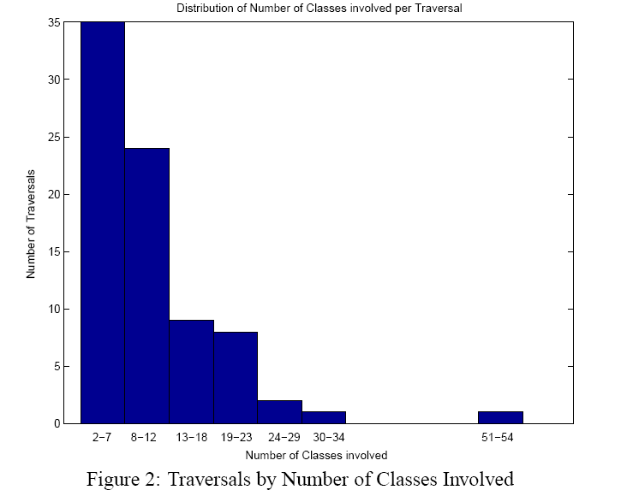
How complex are those traversals?
From: Pengcheng Wu and Mitchell Wand, AOSD 04, SPLAT Workshop
DemeterJ Compiler.
413 classes, 80 traversals
Notes:
Reducing complexity

Slide 65
Outline
AOSD
The LoD and LoDC
AOSD supports LoDC
  AspectJ supports LoDC
  Demeter supports LoDC
LoDC leads to better AOSD
Conclusions
2 ways

Slide 66
Java+DJ
When
WhatToDo
class Source{
HashSet collect(ClassGraph cg)
{return (HashSet)
cg.traverse(this,
“from Source to Target”,
new Visitor(){ … ;
public void before
(Target h) { … }
public void start() {…}});
}
}
How does DJ support the LoDC?
Inserting a call manually into Target would violate the LoDC because our current concern is only WhereToGo.
Notes:
Both aspects may affect 1000 classes

Slide 67
Java+DJ
When
WhatToDo
class Source{
HashSet collect(ClassGraph cg)
{return (HashSet)
cg.traverse(this,
“from Source to Target”,
new Visitor(){ … ;
public void before
(Target h) { … }
public void start() {…}});
}
}
How does DJ support the LoDC?
Inserting traversal calls manually into all classes between Source and Target would violate the LoDC because the collect functionality is a new concern.

Slide 68
How does DJ support the LoDC?
It provides special purpose support for the WhereToGo concern and for the WhenAndWhatToDo concern relative to the WhereToGo concern.

Slide 69
LoD and LoDC style rules
Following LoD style rule:
  Low-level: manual traversal, manual enumeration
  High-level: traversal strategies, wild cards
Following LoDC style rule:
  Low-level: manual enumeration of coordinates
  High-level: coordinate expressions in suitable coordinate systems
Notes:
Use earlier

Slide 70
Outline
AOSD
The LoD and LoDC
AOSD supports LoDC
LoDC leads to better AOSD
  From LoD to structure-shyness and better AOSD
  Information hiding and LoDC
Conclusions

Slide 71
How does LoDC lead to better AOSD?
LoD leads to structure-shyness (e.g., class graph shyness).
Structure-shyness leads to concern-shyness and concern-shyness leads to better AOSD.
AP Library leads to better AspectJ compilation.

Slide 72
Concern-shyness
To be concern-shy with respect to concern X means to program only with respect to the stable portions of concern X. The unstable portions are filled-in algorithmically from the context, e.g., using graph reachability or pattern matching.
The notion of stability is necessarily vague: It relies on our best guess at the moment how the concern will change over time.

Slide 73
Structure-shy: a special case
Structure-shy = concern-shy with respect to X = some structure, e.g., the class graph or the call graph of an application.
Structure-shy programming using DJ means to program only to the stable information of the interface.
Structure-shy programming using AspectJ means to program to the stable information in the interface and method bodies.

Slide 74
How is information hiding different from structure-shyness
CACM May 1972: A technique for the specification of software modules: Hide implementation data structures.
Later: CACM Dec. 1972 Secret = design decision which a module hides from all the others.
Concern-Shyness: hide accidental details of a concern (e.g., structure). Program against stable portions of interface.
information hiding = implementation detail hiding

Slide 75
Problem with Information Hiding
Structure-Shy Programming builds on the observation that traditional information hiding is not hiding enough. Traditional information hiding isolates the implementation from the interface, but does not decouple the interface from its clients.

Slide 76
Decoupling of Interface
Two principles:
  Representation-Independence Principle (1972): the representation of objects can be changed without affecting clients.
  Structure-Shy-Programming Principle (1995): the interface of objects can be changed within certain limits without affecting clients.
Notes:
Structure-shy = program only to the stable portion of the interface
Derive the unstable portion through graph reachability
Concern-shy with respect to concern X = program only with respect to the stable portions of concern X

Slide 77
Structure-shyness in AspectJ
Many AspectJ programs are structure-shy (designed for a family of Java programs)
  Context: Java program or its execution tree (lexical joinpoints or dynamic join points)
Features enabling structure-shyness:
  *, .. (wildcards)
  cflow (graph transitivity)
  this(s), target(s), args(a), call (…), … (inheritance as wild card)

Slide 78
A different application of LoDC: Language extension and aspects
The LoDC (and AO) applies to other domains than OOP, e.g., defining languages.
Language L(G) defined by grammar G covering concern C.
New enhancing concern C’, need new grammar G’.
We would like to enhance s in L(G) to turn it into s’ in L(G’) by using an aspect sentence d.
s’ = s + d (to cover concerns C + C’)

Slide 79
Language extension and aspects
Need a coordinate system in G to point to the places where G’ extends G.
Coordinate system is used to place the enhancements into the sentences.
How can we derive the aspect language from the pair G,G’?

Slide 80
Language extension and aspects
Issues:
  Interaction between multiple extensions.
  What kind of context information is available at coordinates?
  Deriving aspect language from grammar difference between G and G’. Is aspect language complete?

Slide 81
AOSD techniques are popular
The high-level program abstractions used in AOSD are different than ``traditional'' abstractions because of the analogous adaptation they cause.
AOSD practitioners using tools such as AspectJ, AspectWerkz, Spring AOP Framework, JBoss-AOP, JAC, DemeterJ etc. (see http://www.aosd.net) are happy to work with AOP abstractions.

Slide 82
AOSD techniques are popular
One reason is that aspects produce a lot of behavior that would be
  tedious and error-prone to write by hand and
  the code would be scattered over many methods and not pluggable.
Instead of labeling aspects as wrong or breaking modularity, it is much better to find good ways of working with them.

Slide 83
Open issues
How to follow LoDC: There are many open questions
  Suitable high-level coordinate systems.
  Aspect-specific languages.
  Study limited forms of aspects. E.g., the D*J tools: DemeterJ, DJ, DAJ.
  Interaction between aspects. Concern-shyness.
  Reasoning about aspects, e.g., what is the resource consumption of an aspect.

Slide 84
Outline
AOSD
The LoD and LoDC
AOSD supports LoDC
LoDC leads to better AOSD
Conclusions

Slide 85
Conclusions
AOSD is an important emerging technology to control the complexity of software designs.
The LoDC is a useful style rule to better apply, explain and understand AOSD.
Properly following the LoDC (finding good decompositions into separable aspects that are loosely coupled) is still an issue with many questions attached. But the AOSD community will ultimately succeed in addressing those questions.
Thank you! Question Time.
Notes:
Properly following the LoDC (finding good decompositions into separable aspects that are loosely coupled) is still an issue with many questions attached. But the AOSD community will ultimately succeed in addressing those questions.

Slide 86
old

Slide 87
Thank You!
Questions?

Slide 88
Demeter 1.
You: object
Talk: Refer to parts
Friends: stable parts
Concern:
  New: WhereToGo
Coordinates: object parts
Examples:
  From BusRoute via BusStop to Person
Talk only to your stable friends that contribute to your concerns

Slide 89
Law of Demeter for Concerns (LODC)
contributing friends
FRIENDS
you
coordinates

Slide 90
Law of Demeter for Concerns (LODC)
contributing friends
FRIENDS
new
you
coordinates

Slide 91
Protect Against Changes.
Protection against changes in data representation and interfaces. Traditional technique: information-hiding is good to protect against changes in data representation. Does not help with changes to interfaces.
Need more than information hiding to protect against interface changes: restriction through shy programming, called Adaptive Programming (AP).
Implementation
Interface
Client
Representation Independence
Shy Programming
Information Hiding

Slide 92
Why object form is needed
A = B D E.
B = D.
D = E.
E = .
class A {
void f() {
this.get_b().get_d().get_e();
}
}

Slide 93
Object Form
A = B D E.
B = D.
D = E.
E = .
a1:A
b1:B
d1:D
e1:E
d2:D
e2:E
class A {
void f() {
this.get_b().get_d().get_e();
}
}
e3:E
not a preferred
supplier object

Slide 94
Object Form
A = B D E.
B = D.
D = E.
E = .
a1:A
b1:B
d2:D
e2:E
class A {
void f() {
this.get_b().get_d().get_e();
}
}
e3:E
is a preferred
supplier object
(through aliasing)

Slide 95
Commonality between summing and logging

Slide 96
Leads to or helps explain/implement
Overview
Controlling Information
Overload
Separation of
concerns
Is-a
Structure
Shyness
AspectJ
Automata
Theory
LoD
LoDC
Visitors
Traversal
Strategies
Aspects
Demeter
Complex Requests
Adaptation
Dilemma
Subjects
LoDC = Talk only to your friends that contribute to your concerns

Slide 97
OO interpretation of LoD
Talk only to your friends
  Class form: you = method of class, talk = use, friends = preferred supplier classes
  Object form: you = method of object, talk = send message, friends = preferred supplier objects

Slide 98
LoD Formulation (object form)
Inside a method M we must only call methods of preferred supplier objects (for all executions of M).
Expresses the spirit of the basic LoD and serves as a
conceptual guideline for you to approximate.

Slide 99
Preferred supplier objects of a method
the immediate parts of this (computed or stored)
the method’s argument objects (which includes this)
the objects that are created directly in the method

Slide 100
Law of Demeter (LoD)
Talk only to your friends
you
FRIENDS

Slide 101
Aspectual algorithms
Self application
  Develop design tools for aspectual algorithms
  Apply design tools to our design tool algorithms themselves

Slide 102
Leads to or helps explain/implement
Overview
Controlling Information
Overload
Separation of
concerns
Is-a
Structure
Shyness
AspectJ
Automata
Theory
LoD
LoDC
Composition
Filters
Visitors
Traversal
Strategies
Aspects
Demeter
Complex Requests
Adaptation
Dilemma
Subjects
LoDC = Talk only to your friends that contribute to your concerns

Slide 103
Subject-oriented Programming.
You: object
Talk: refer to members
Friends c.c.: members of a concern
Concerns:
  New: behavior cutting across several classes
Coordinates: objects and object members

Slide 104
Leads to or helps explain/implement
Overview
Controlling Information
Overload
Separation of
concerns
Is-a
Structure
Shyness
AspectJ
Automata
Theory
LoD
LoDC
Composition
Filters
Visitors
Traversal
Strategies
Aspects
Demeter
Complex Requests
Adaptation
Dilemma
Subjects
LoDC = Talk only to your friends that contribute to your concerns

Slide 105
Scattering: count number of classes to which color goes
ordinary program
aspect-oriented prog.
structure-shy
functionality
C1
Concern 1
C2
object structure
Concern 2
C3
synchronization
Concern 3
Notes:
avoid tangled programs
AOP

Slide 106
Crosscutting and LoDC
AOSD is about modularizing crosscutting concerns whose ad-hoc implementation would be scattered across many classes or methods.
LoDC does not talk directly about crosscutting but experience shows that the complex request influences often many classes and methods.

Slide 107
Outline
Motivation, Thesis
What is AOSD?
AOSD as an emerging technology (reports from IBM)
The LoD and LoDC
AspectJ supports LoDC
Introduction to Demeter
Demeter supports LoDC
From LoD to structure-shyness and better AOSD
Information hiding and LoDC
Open Problems
Conclusions

Slide 108
Program against stable information in interface and implementation.
Stability is better if organization is good
Concern-shyness
Mismatch:
  interface can change
  Implementation can change
  Need interface to implementation

Slide 109
Adaptation Dilemma
When a parameterized program abstraction P(Q) is given with a broad definition of the domain of the allowed actual parameters, we need to retest and possibly change the abstraction P when we modify the actual parameter, i.e., we move from P(Q1) to P(Q2).
Application of the rule: Reusing a piece of software in a new context requires retesting.

Slide 110
Examples for Adaptation Dilemma
AspectJ: After change to the base program an aspect suddenly misbehaves (e.g., our Law of Demeter checker written in AspectJ).
Demeter: After a change to the class graph, a traversal strategy suddenly misbehaves (e.g., adding a new edge introduces many more undesired paths).

Slide 111
Outline
AOSD
  What is AOSD?
  AOSD as an emerging technology
The LoD and LoDC
AOSD Tools support LoDC
  AspectJ supports LoDC
  Demeter supports LoDC
LoDC leads to better AOSD
  From LoD to structure-shyness and better AOSD
  Information hiding and LoDC
Conclusions

Slide 112
An Empirical Study of the Demeter System
Pengcheng Wu and Mitchell Wand
Northeastern University
AOSD 04, SPLAT Workshop

Slide 113
Motivation
Collect evidence to support the claim: The Demeter system improves the
  comprehensibility of software systems.
  structure-shyness of software systems.
Notes:
What is motivation?

Slide 114
System overview
Problem addressed: manual implementation of a traversal on a complex object structure is tedious and error-prone. E.g., AST traversal.
Solution: have a high-level description of traversals, then generate the code!
The largest software system using Demeter’s traversal strategies: the DemeterJ Compiler. It has 413 classes, 80 traversals on ASTs.

Slide 115
How complex are those traversals?

Slide 116
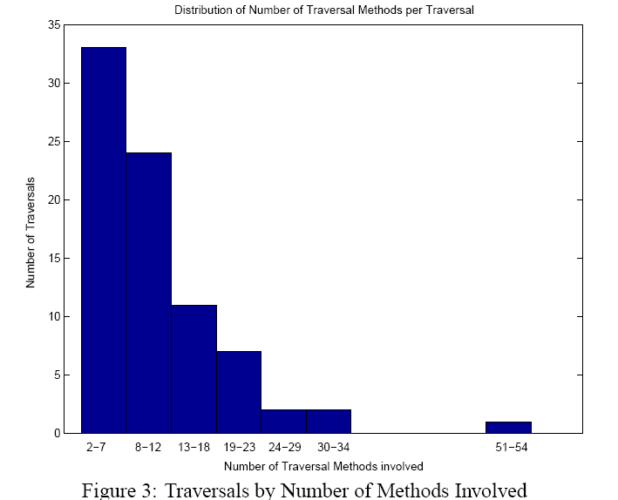
How complex are those traversals? (cont.)

Slide 117
Traversal strategies improve comprehensibility
How to measure the improvement?
Abstractness of a traversal strategy
= Length(MethodCallPaths)/Length(Strategy)
The larger the ratio is, the more abstract the strategy is, then the more details are left out and the better comprehensibility we achieve.

Slide 118
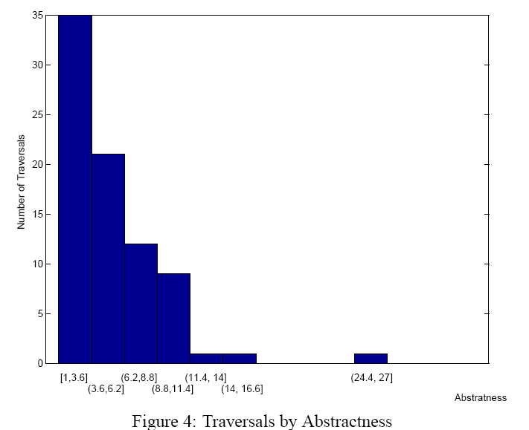
The abstractness metric

Slide 119
Result
High level description of traversals helps improve the comprehensibility of the traversal concerns.
The improvements are nontrivial.
At least in this application: following the Law of Demeter using traversal strategies leads to structure-shyness.

Slide 120
Strengthening Information Hiding
may change
may change
in limits
Implementation
Interface
Client
Representation Independence
Structure-Shy Programming
Information Hiding

Slide 121
Structure-shy Programming
  Client implementations don’t need updating even if interfaces change.
  Interfaces
  Implementation

Slide 122
Product of non-deterministic automata
Product of strategy graph and class graph: produces traversal graph encapsulating a set of paths in class graph
Product of traversal graph and object graph: produces subgraph of object graph where traversal visits

Slide 123
The Power of AspectJ
Language/ Principle | Representation Independence | Structure-shy Programming
AspectJ | May be violated | yes
Demeter | yes | yes
Notes:
May be violated because we might program against the stable parts of the method bodies.

Slide 124
Demeter.
You: object
Talk: method calls
Friends contributing to concern.: traversal method calls (WhereToGo)
Concerns:
  Old: WhereToGo
  New: WhenAndWhatToDo
Coordinates: objects and object parts
Examples:
  Where: void before (Class_WhereToGo host)
  Weave: ClassGraph.traverse (obj, WhereToGo,
  WhenAndWhatToDo);
Notes:
We could do this for many more

